Slide 1


Futurense Technologies
Project Report
TOPIC- PERSONAL VOICE ASSISTANT
TAPABRATA BANERJEE(22BTRAD030)

Slide 2
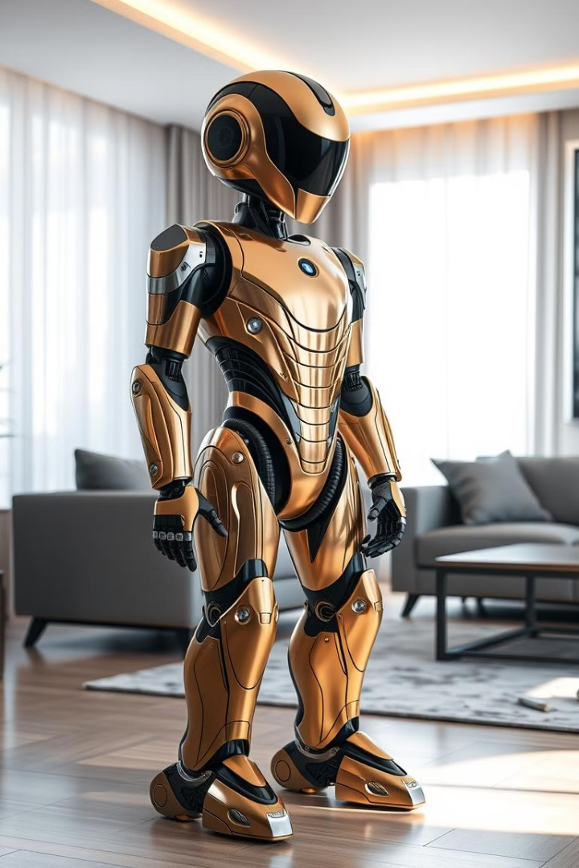
Personal Voice Assistant using Python: Unleashing the Power of Jarvis
This presentation explores the creation of a personal voice assistant using Python. We will delve into the fundamental components of a voice assistant system, the power of Python in voice assistant development, and how to integrate external APIs and information sources for enhanced functionality.

Slide 3

Introduction to Voice Assistants and their Applications
1
Voice Control
2
Information Retrieval
Voice assistants enable hands-free interaction with devices and services.
They can quickly provide information, answer questions, and even play music.
3
Automation
Voice assistants can automate tasks, such as setting reminders, scheduling appointments, and controlling smart home devices.

Slide 4
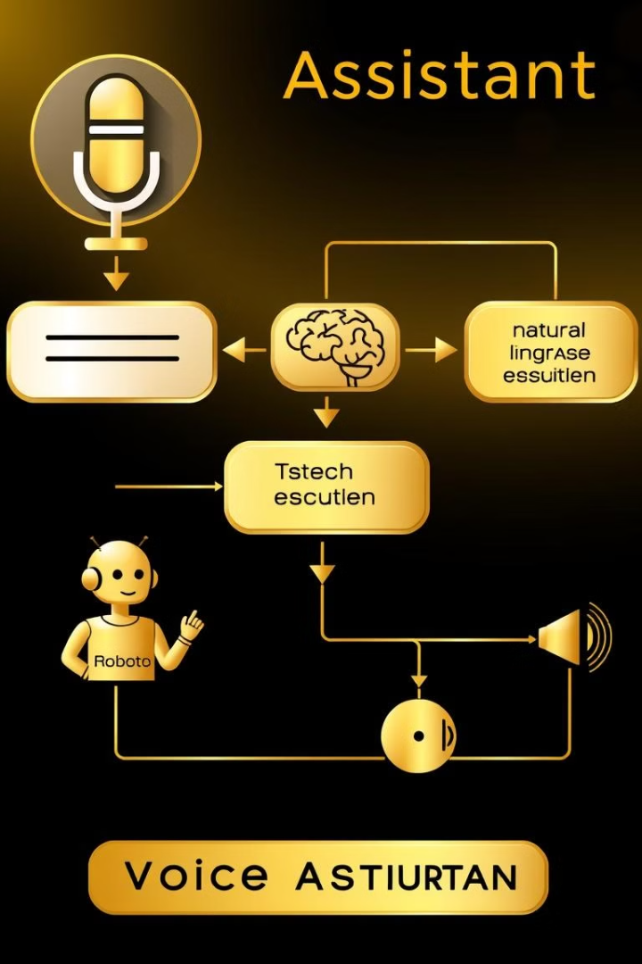
Key Components of a Voice Assistant System
1
Speech Recognition
Converting spoken words into text.
2
Natural Language Processing
Understanding the meaning and intent behind the text.
3
Response Generation
Formulating a suitable response based on the user's input.
4
Text-to-Speech
Converting the response into spoken audio.

Slide 5
Leveraging Python for Voice Assistant Development
Libraries
Framework
Benefits
SpeechRecognition
Python's versatility and extensive libraries make it a powerful choice for voice assistant development.
Python simplifies speech recognition, natural language processing, and text-to-speech tasks, making it an ideal language for voice assistant projects.
Pyjokes
Webbrrowser
pyttsx3
os

Slide 6




Speech Recognition and Natural Language Processing
Speech Recognition
Capturing audio input and converting it to text.
Natural Language Understanding
Analyzing the text to identify its meaning and intent.
Contextual Analysis
Understanding the context of the user's request to provide relevant responses.

Slide 7

Text-to-Speech Functionality and Synthesis
Library
Functionality
gTTS
Text-to-Speech Synthesis
PyTTSx
Real-Time Speech Synthesis

Slide 8

Integrating External APIs and Information Sources
Weather API
News API
Retrieving real-time weather information for specific locations.
Providing updates on current events and headlines.
Social Media API
Interacting with social media platforms, such as Twitter and Facebook.

Slide 9
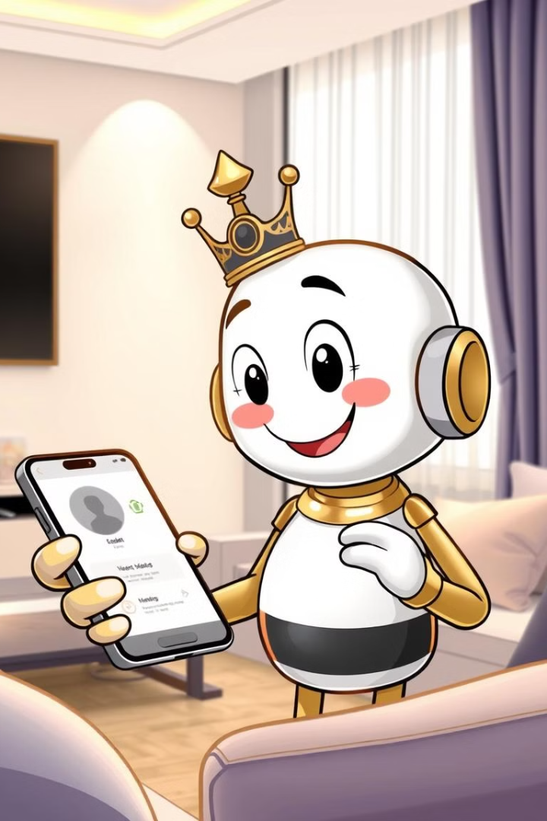



Enhancing the Voice Assistant with Personality and Interactivity
Voice Modulation
Adjusting the tone and pitch of the voice assistant to reflect different emotions.
Conversational Flow
Creating natural and engaging dialogue patterns to enhance user interaction.
Humor and Wit
Incorporating humor and wit into the voice assistant's responses to make it more entertaining.

Slide 10



Deployment and Scaling the Personal Voice Assistant
Development
Deployment
Scaling
Developing the voice assistant application using Python.
Deploying the application to a cloud platform for accessibility.
Scaling the application to handle increased user traffic and requests.

Slide 11
Thank You
By
Tapabrata Banerjee
AIDE 2022-2026
USN – 22BTRAD030

